Slide 1





VC PART -1
KICK OFF – MON AUGUST 15

Slide 2

MON
AUGUST 15
KICK OFF
WED
AUGUST 31
FINAL PRES
2 WEEKS
ITERATIONS
VC PART 1

Slide 3

Full time during 2.5 weeks
8 HOURS PER DAY
From AUGUST 15TH to AUGUST 31th

Slide 4
WHAT IS MISSING ?
Experience 60% of software development process
IMPLEMENTATION
COSTING/PLANNING
AGILE
TEST
DEPLOYMENT

Slide 5
GITHUB BOARD
LARAVEL
REST API
HTML/CSS
DB
AGILE
JAVASCRIPT
FIND THE USELESS SKILL
Practice and use nearly what you learned at PNC.
TESTING
ERD
VUE
NPM - COMPOSER
COMPONENTS

Slide 6
ROLES & RESPONSABILITIES

Slide 7


Project Manager
Train the week leader
Review assigned tasks and progress
Control deadlines
Support technically the team
SCRUM MASTER
Launch the daily meeting with his/her team member
Create the tasks on GITHUB and assign them to the team
Follow the team progress on tasks
Students Group
Development team of the virtual company
Manage their “internal organization”

Slide 8

PROJECT MANAGER
DAILY meetings with TEAM
Train the SCRUM MASTER
Review assigned tasks and progress
Control deadlines
Support technically the team

Slide 9

SCRUM MASTER
Changes every week
Everyone will be leader
Write the GitHub issues for the week
Assign the milestone, the student and monitor them every day
Follow his/her team progress
Communicate with PM
Plan the meeting, send a list of questions
Lead the meeting
Demonstration – Q/A - Minute meeting and work log

Slide 10
TEAM MEMBERS
Update their task on GITHUB
Progress
Comments
Create new tasks if needed
Code and commit their code
Communicate with the SCRFUM MASTER about their progress

Slide 11
PLANNING
THU AUGUST 15
MON AUGUST 22
ITERATION 1
DEMO TO PM
MON AUGUST 22
MON AUGUST 29
ITERATION 2
DEMO TO PM
WED AUGUST 31
JURY

Slide 12
ITERATION- BASED PROCESS
ITERATION 1
ITERATION 2
COSTING/PLANNING
COSTING/PLANNING
IMPLEMENTATION
IMPLEMENTATION
TEST
TEST
DEPLOYMENT - LOCAL
DEPLOYMENT - LOCAL

Slide 13

MONDAYS = WEEKLY
BUGS FROM
PREVIOUS ITERATION
FEATURES FOR
THIS ITERATION
NEXT ITERATION

Slide 14
GITHUB ORGANISATION

Slide 15
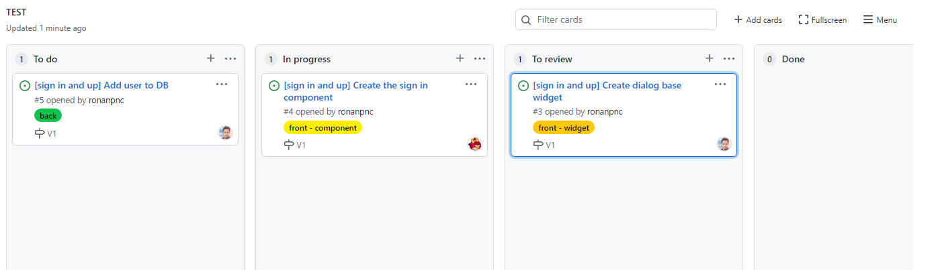
Your board is your main tool for your project management

Slide 16

GITHUB
WHAT YOU NEED TO KNOW
How to create a milestone
How to create labels
Assignee
Type
Milestone
How to create an issue
How to monitor an issue
How to link GIT commit to this issue
How to interact with customer using the issue

Slide 17
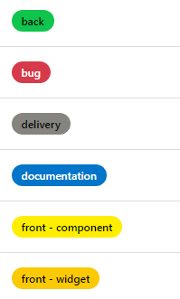
MANDATORY LABELS
Migration, controller, model, routes…
Any bug to fix
Activities related to a DEMO / DELIVERY : validation, production, demo slides
ERD , Mock up , Component diagram, routes decryption
View component and inner components
Widgets re-usable ( ex : dialogs …)

Slide 18
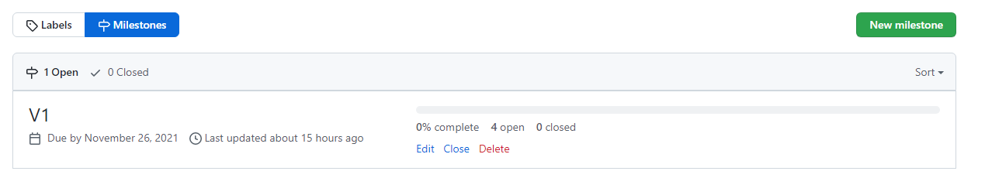
MILLESTONE = the WEEK ITERATION

Slide 19
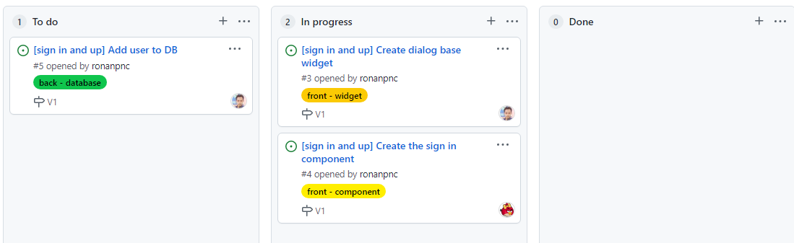
DEMO : CREATE THE ISSUES
Issue name = [BRANCH NAME] + title
Issue shall be assign to 1 member
Issue shall have a LABEL, MILLESTONE, description

Slide 20
REQUIRED DOCUMENTS

Slide 21

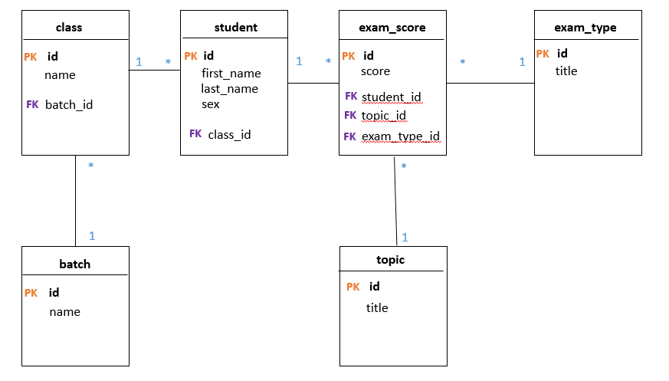
1-REQUIRED DOCUMENTS : ERD
This document shall be put in /document folder

Slide 22
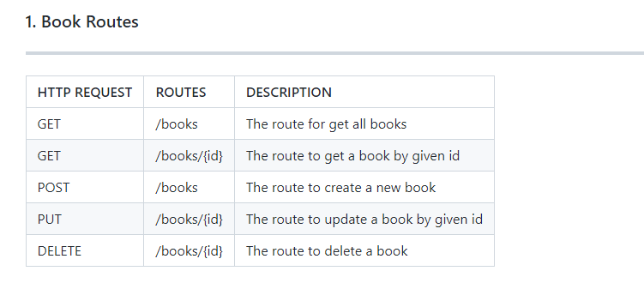
2-REQUIRED DOCUMENTS : ROUTE
This document shall be put in /document folder

Slide 23
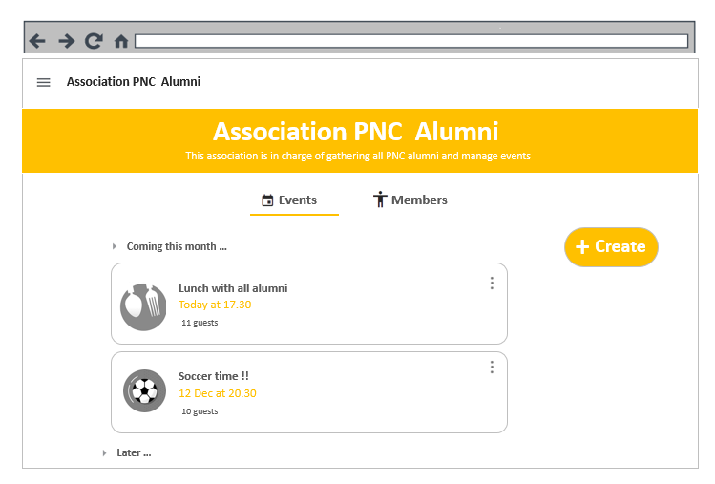
3-REQUIRED DOCUMENTS : MOCK UP
This document shall be put in /document folder

Slide 24
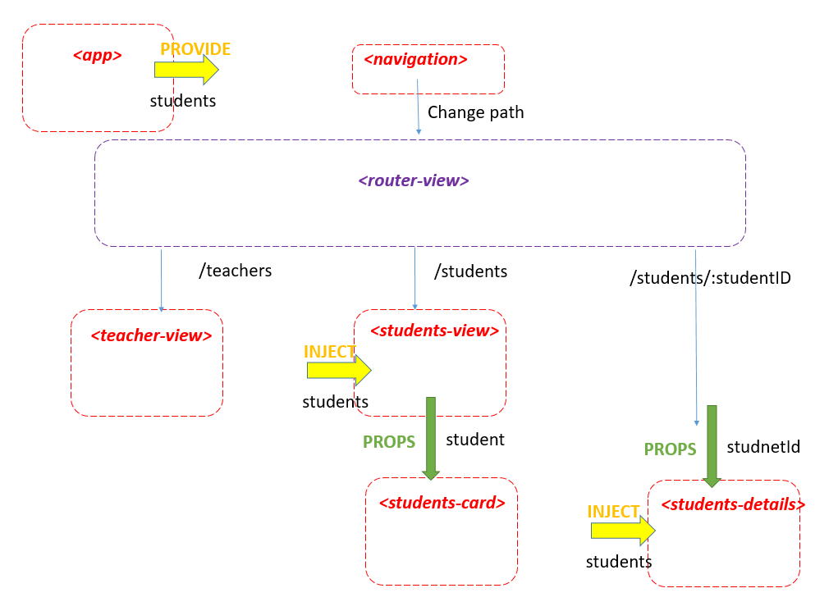
4-REQUIRED DOCUMENTS : COMPONENTS
This document shall be put in /document folder

Slide 25
<app>
<app>
PROVIDE
Students[]
Students[]
Students[]
// A component with a list of student as data
// app provides students to anymore
INJECT
<dialog>
<app>
PROPS
<card>
Students[]
Students[]
Students[]
Students[]
student
// dialog gets students from a provider
// app send student to card
<router-view>
// Vue JS built-in component
EMIT
<parent>
<from>
Students[]
Students[]
valided
// from send the event validated to parent

Slide 26
EVALUATION

Slide 27
1
2
Iterations
performances
Team Presentation
performance
70%
30%
FINAL GRADE

Slide 28
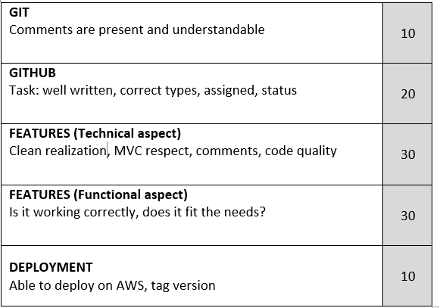
FRONT separation into components , communication, UI, error prevention
BACK : ROUTES + DB MODEL + VALIDATION OF DATA
ALL Clean code
PROJECT MANAGER
Evaluation
ENVIROMENT configuration of development / production
DELIVERY : deploy on AWS , tag version

Slide 29
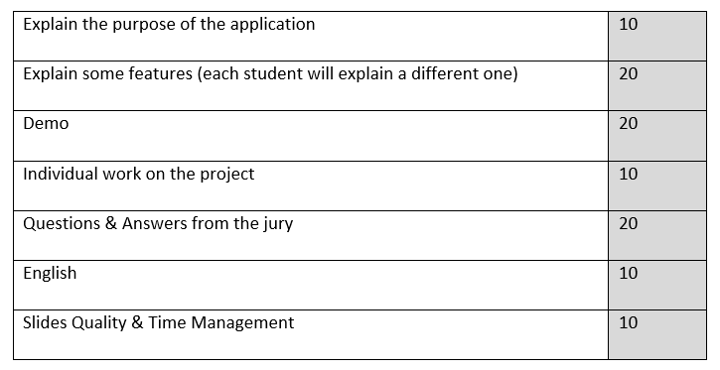
FINAL
PRESENTATION
25 MIN PER GROUP

Slide 30
GROUPS & COACHES & SCRUM MASTERS

Slide 31

SHORT VIDEO VC CONTEST
FUN TIME
Present your team in 2 min max
Originality required !
Deadline MONDAY to submit your video to : TEACHER RADY

Slide 32
TODO TODAY
Meet with your team
Understand the documents
Understand the task for this week
Prepare the question for your PM
Meet your PM
Write the list of issues for this week ( scrum master)
Assign the issues to members

